Slide 1
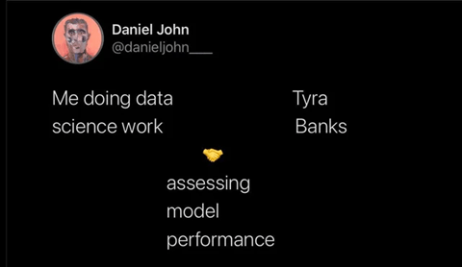
Topic 5 – (Over)Fitting and Evaluating Models
Statistics and Data Analysis
COR1-GB.1305
Prof: Chris Volinsky
NYU Stern: Spring 2024

Slide 2
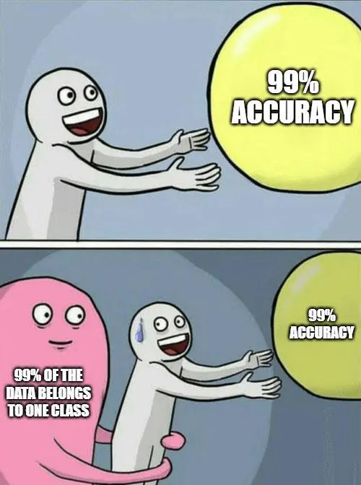
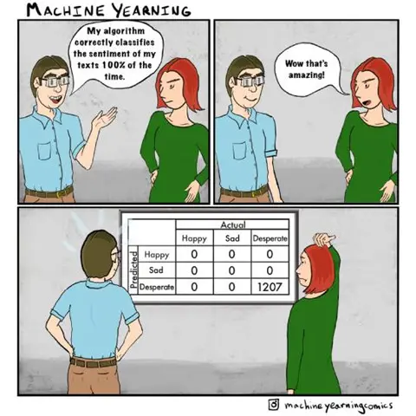

Slide 3
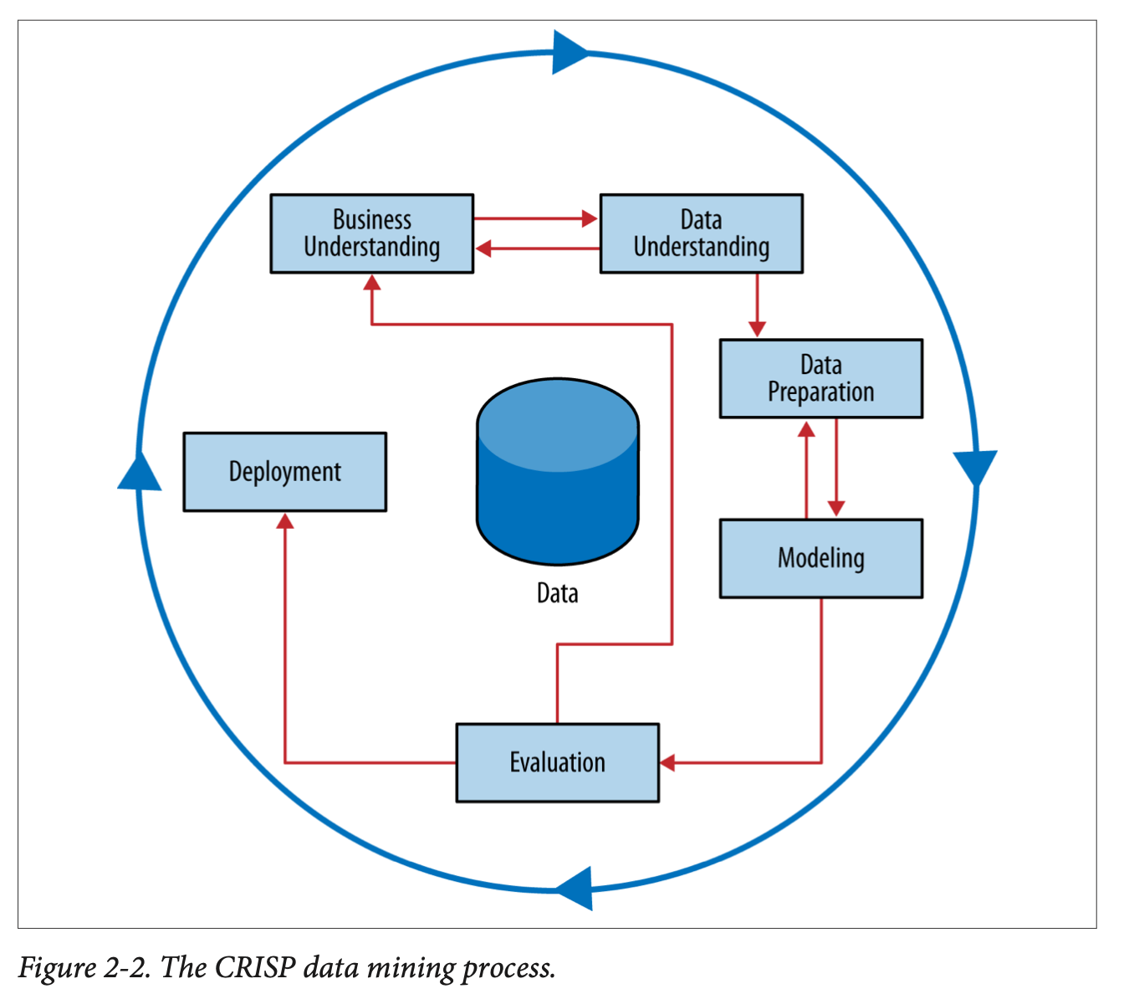

Slide 4
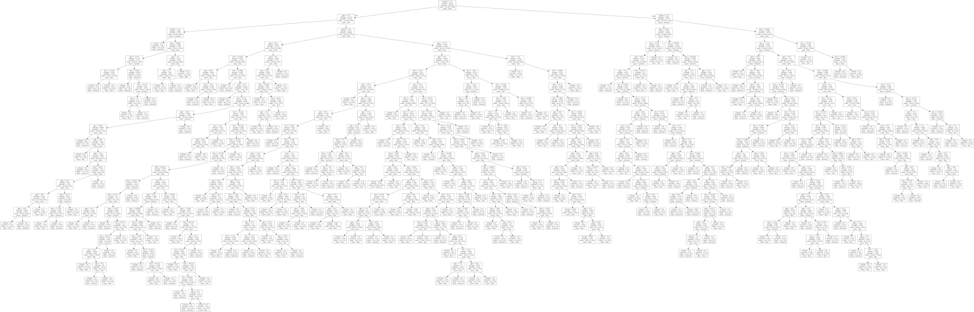
Evaluating models
Consider a tree model. How do we assess how good it is?
I can build a tree big enough that each leaf node has its own prediction! 100%!
The goal of data science: To generalize to data we have not seen yet

Slide 5
Evaluating models
Consider a tree model. How do we assess how good it is?
Easiest measure – accuracy – how many are correct?
By this measure – the biggest tree will always be best!
Trees built to their conclusion are:
Large
Overly complex
Too specific to the data used for training
Poor for generalizing outside the data

Slide 6
Evaluating models
How do we protect against this?
Training / test data
Original data
Training Data
(80%?)
Test (holdout) data
(20%?)
Using holdout data for performance metrics gives a better estimate of how the model will perform in the “real world”
From sklearn.model_selection import train_test_split

Slide 7

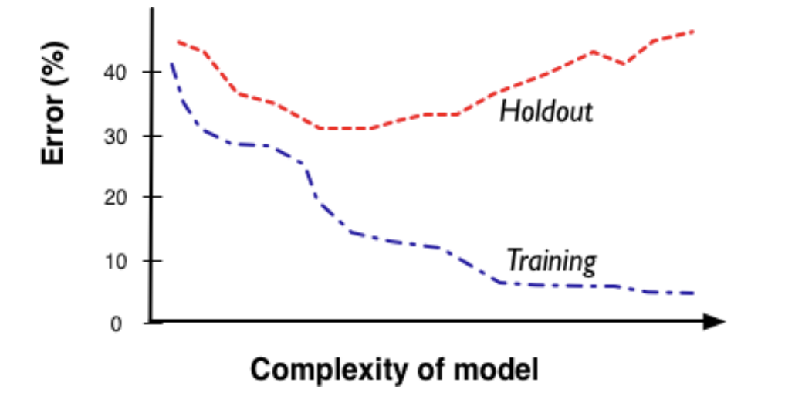
Complexity vs. Error
Overfitting: model is too comples: the model fits great on the training data but doesn’t generalize to holdout data because it is “memorizing” the training data.
This is one of the most important concepts of machine learning
Models always get better with more data or more complexity
But need holdout data to optimize generalizability
Notes:
Remember how R^2 always gets better when you add variables!!

Slide 8
Complexity vs. Error
All Models have complexity parameters:
Tree models => number of nodes, number of variables
Regression models => number of attributes, degree of polynomial
Neural Nets => layers, complexity of functions
Notes:
Complexity control

Slide 9
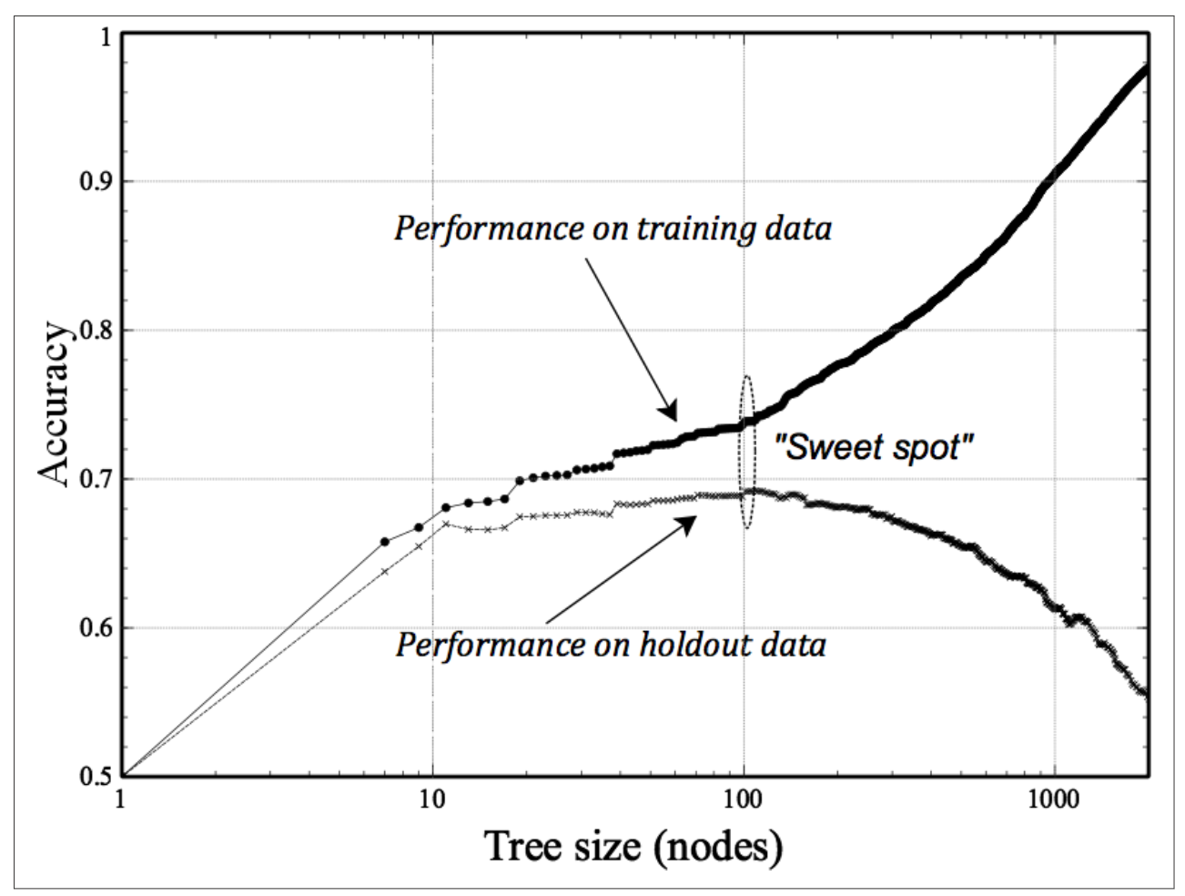
Using Holdout sets for Tree induction
You can use the complexity tradeoff to find the best size for a tree
Different axis than last plot:
Accuracy vs error
Note: log scale on nodes

Slide 10
Cross-validation
We can use fitting graphs like the one we just saw to balance complexity with performance, and estimate the performance.
BUT maybe this performance curve is a function of the specific 80/20 split that we chose!
Think about our tree example, we evaluated all tree sizes on the same holdout set…this could also lead to memorization
To get the best generalization error estimate, we could account for that randomness…by using several random hold-outs
Cross-validation is the way to get around this!

Slide 11
Cross-validation
Cross validation can be used to select parameters (like the size of the tree) or to estimate the performance of a given selected model
Cross-validation algorithm
Split data into k equal sets, called folds
Fit model with sets (1,…,k-1), measure performance on fold k
Subsequently fit k times using each fold as a hold-out
For each iteration, measure predictive performance, or the metric of interest
from sklearn.model_selection import cross_val_score
cross_val_score(model, X, Y, scoring="accuracy", cv=5)

Slide 12
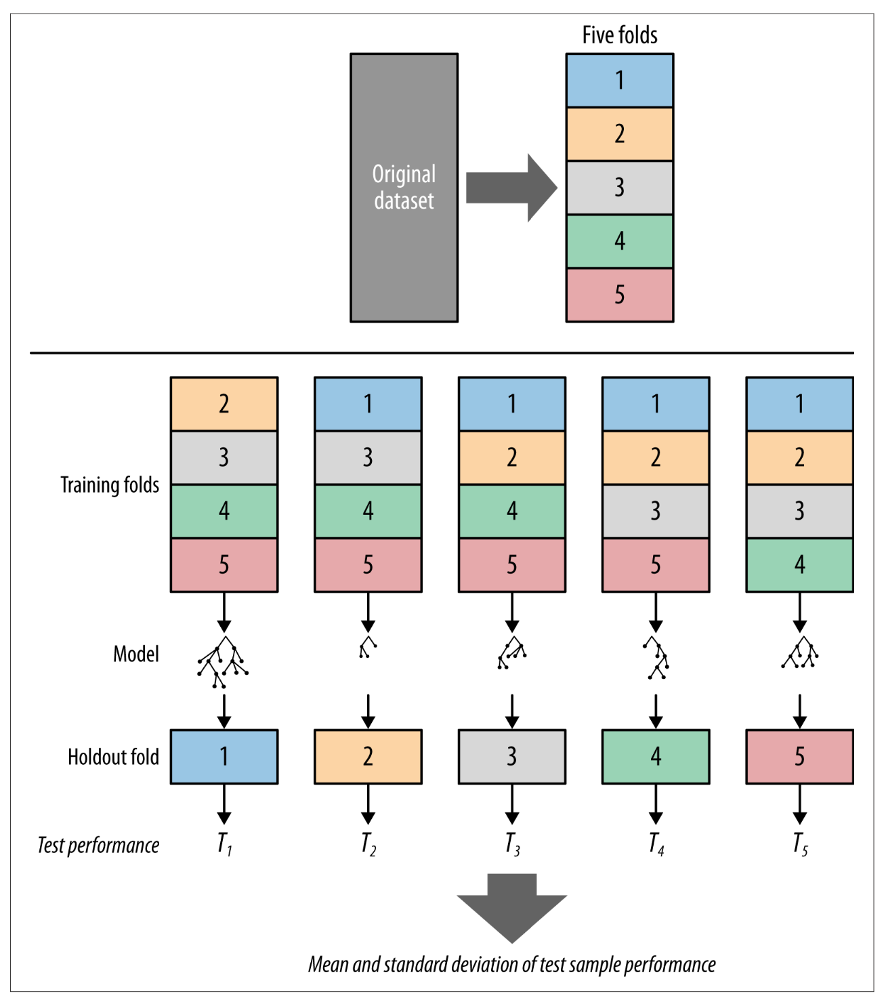

Slide 13
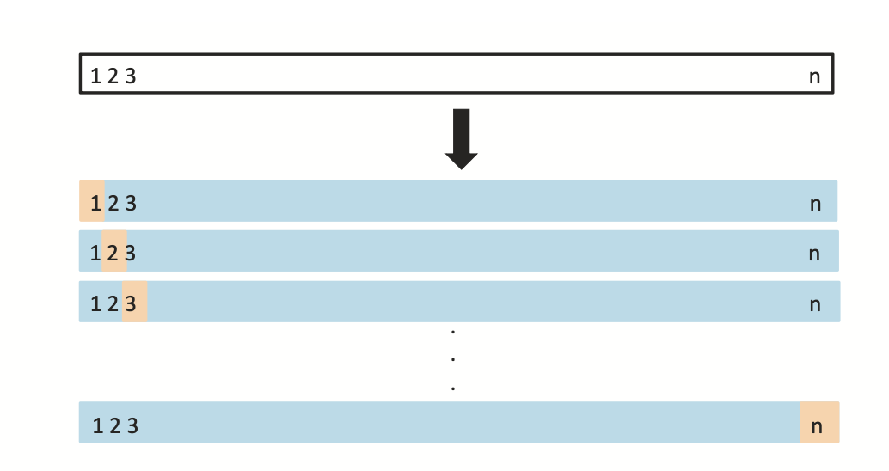
Leave One Out Cross Val (LOOCV)
You can take cross-validation to the extreme:
Fit model on all but one data point
Predict on the single data point and measure error
Do that N times, once for each data point:
LOOCV is the best in terms of estimating true error
BUT – can be very time-consuming
from sklearn.model_selection import LeaveOneOut, cross_val_score
loo=LeaveOneOut()
cross_val_score(model, X, Y, scoring="accuracy", cv=loo)
ISL p 205

Slide 14
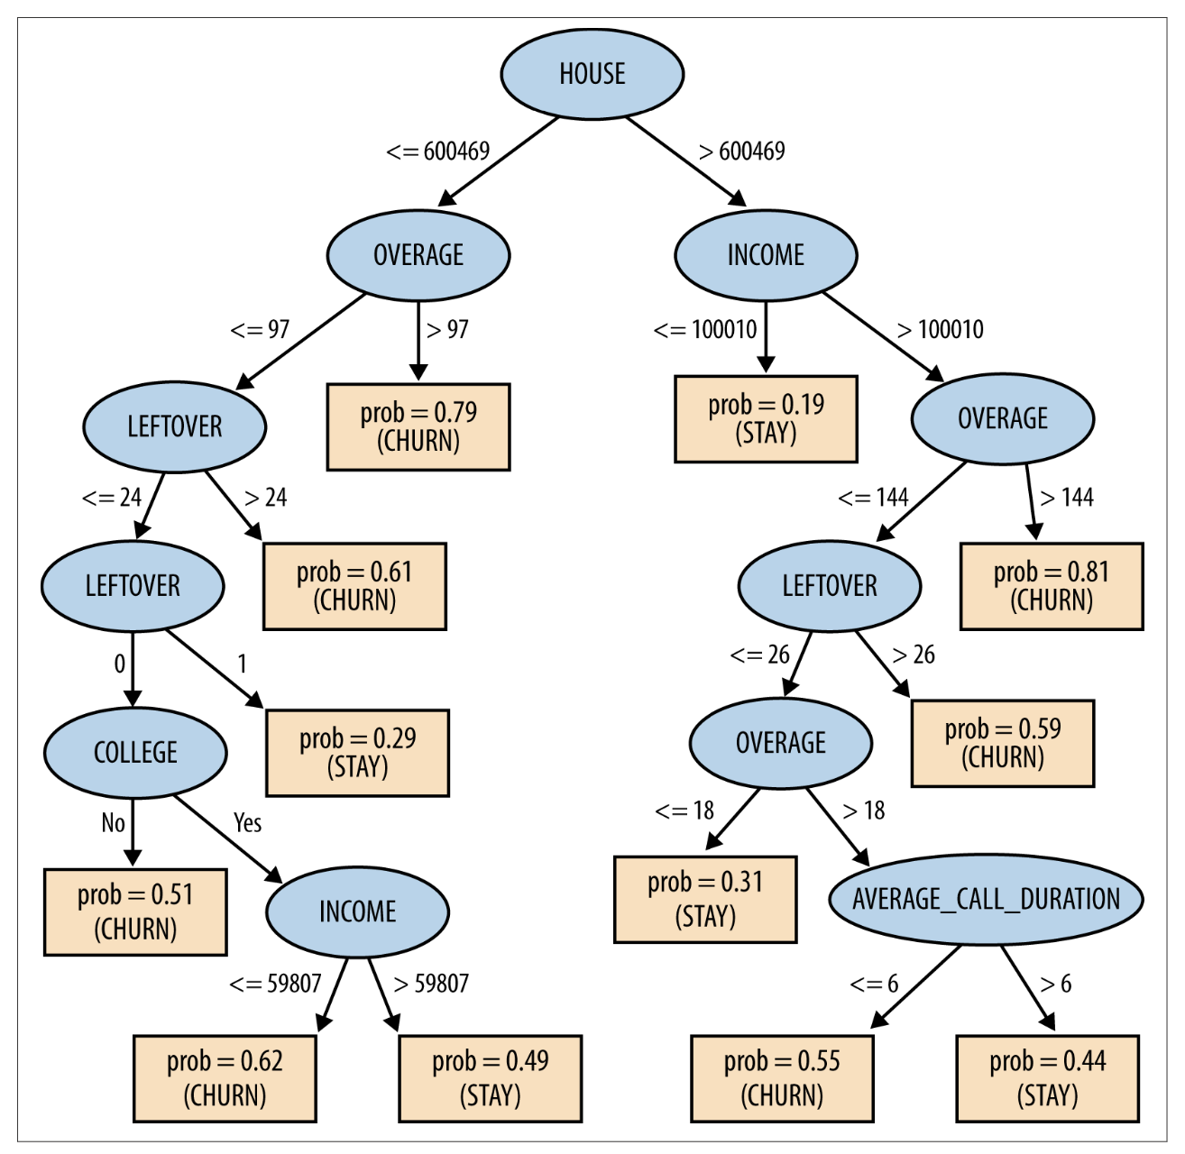
Example : predicting churn
Churn accuracy on training set =73%

Slide 15
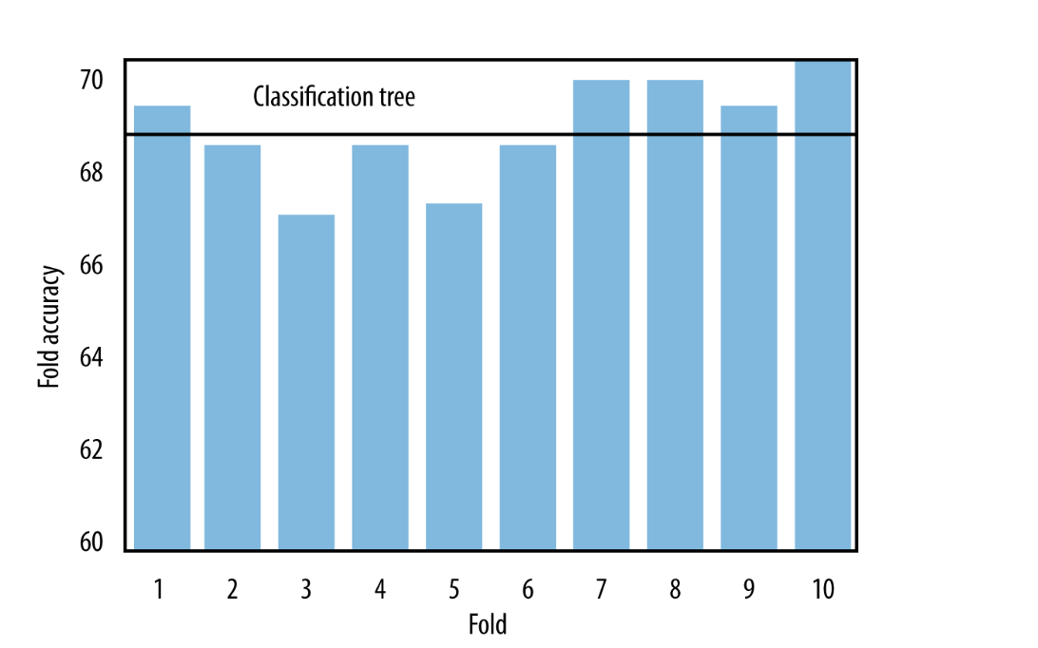
Example : predicting churn
10-fold cross-val:
Average accuracy across all folds = 68.6%
More realistic estimate of the accuracy that will be seen in the real world
DSB: p140
Notes:
Go back to our example

Slide 16
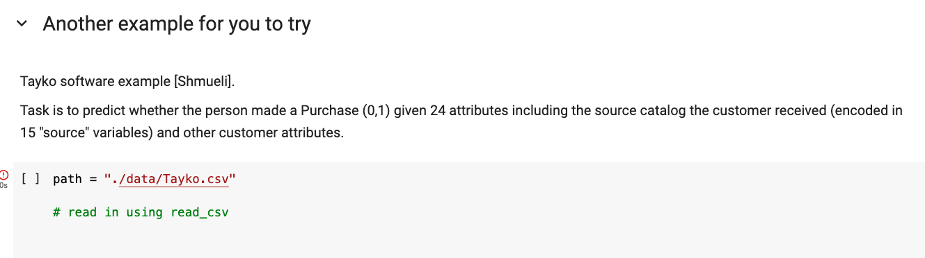
Back to our example

Slide 17
Module3: Fitting Curves and Cross-Validation
Fitting_and_overfitting.ipynb

Slide 18
Validation set
Even though cross-validation accounts for training bias, we are still using and re-using the data to get estimates of performance
In cases where accurate estimation of the performance is critical, it may be useful to create a third partition of the data
This provides a truly “untouched” data set that can be used to give accurate estimates of performance
To do this:
Split original data into two sets as before 80/20 split – with the 20% being an untouched hold-out set
Split training data again (e.g. 60/20) – into training and validation sets
Use Training/validation to set parameters (e.g. optimal tree_depth and tree) and then simply apply to the Holdout data
Training Data
(60%?)
Validation data
(20%?)
Test/Holdout
data
(20%?)

Slide 19
Evaluating Classification Models

Slide 20
Model Performance
Classification models predict what class an instance (example) belongs to.
E.g., good vs. bad credit risk (Credit), Response vs. no response to a direct marketing campaign, etc.
Evaluation measure: Classification Accuracy
Proportion of accurate classifications of examples in test set. E.g., the model predicts the correct class for 70% of test examples.
Actual prediction is based on the majority prediction (cutoff at 50%)
What are the possible problems with this?
Notes:
What if the overall “truth” is not 50%?
What if the cost of something is much higher? You are willing to accept a much smaller probability.
What if I can only take action on a smaller percent (budget for a task)?

Slide 21
Probability to Classification
Consider our Churn example, and using a tree model to predict churn
Inputs |  |  |  | Target | Model’s Prediction | Predicted Class ?
Contract | CareCalls | Age | Income | churn | P(churn) | churn
0 | 1 | 28 | 39K | 1 | 0.81
1 | 2 | 56 | 183K | 0 | 0.31
0 | 5 | 61 | 63K | 0 | 0.72
0 | 1 | 28 | 20K | 1 | 0.54
1 | 2 | 33 | 50k | 0 | 0.51
… | … | … | … | … | …

Slide 22
Probability to Classification:
Use standard cutoff at 0.5
If p(churn) > 0.5 then predict churn = 1
Inputs |  |  |  | Target | Model’s Prediction | Predicted Class
Contract | CareCalls | Age | Income | churn | P(churn) | churn
0 | 1 | 28 | 39K | 1 | 0.81 | 1
1 | 2 | 56 | 183K | 0 | 0.31 | 0
0 | 5 | 61 | 63K | 0 | 0.72 | 1
0 | 1 | 28 | 20K | 1 | 0.54 | 1
1 | 2 | 33 | 50k | 0 | 0.51 | 1
… | … | … | … | … | …

Slide 23
Probability to Classification:
Use standard cutoff at 0.5
Inputs |  |  |  | Target | Model’s Prediction | Predicted Class | Correct/ incorrect
Contract | CareCalls | Age | Income | churn | P(churn) | churn
0 | 1 | 28 | 39K | 1 | 0.81 | 1 | √
1 | 2 | 56 | 183K | 0 | 0.31 | 0 | √
0 | 5 | 61 | 63K | 0 | 0.72 | 1 | X
0 | 1 | 28 | 20K | 1 | 0.54 | 1 | √
1 | 2 | 33 | 50k | 0 | 0.51 | 1 | X
… | … | … | … | … | … | …

Slide 24
Probability to Classification:
What cutoff correlates best to the action we would take….
Try another cutoff = 0.8
Inputs |  |  |  | Target | Model’s Prediction | Predicted Class | Correct/ incorrect
Contract | CareCalls | Age | Income | churn | P(churn) | churn
0 | 1 | 28 | 39K | 1 | 0.81 | 1 | √
1 | 2 | 56 | 183K | 0 | 0.31 | 0 | √
0 | 5 | 61 | 63K | 0 | 0.72 | 0 | √
0 | 1 | 28 | 20K | 1 | 0.54 | 0 | X
1 | 2 | 33 | 50k | 0 | 0.51 | 0 | √
… | … | … | … | … | … | … | …
Notes:
Don’t expect 50% churn
Cant act on it anyway
Maybe acting is expensive

Slide 25
What cutoff to choose?
Depends on:
- the baserate
- what action we intend to take
- the cost of the action we intent to take
- overall performance of the split
- the distribution of the predictions
- the costs of errors
We may want to explore multiple cutoffs

Slide 26
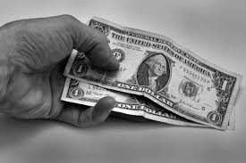
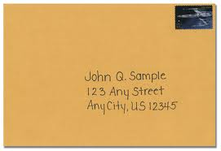
Example: Non-profit Mailing
You work for a non-profit company with a big mailing list
You want to send a nice mailing with a solicitation to give to the charity
You build a model to predict who is likely to respond to the mailing based on previous donations, demographics, and other features.
Notes:
Question: What factors might go into determining who you send the mail to?
AKA – where do you set the threshold
Depends on cost, budget
Probability of success
Cost of type 1 and type 2 error
Lead them to..what are the errors….

Slide 27
Practical Example: Non-profit Mailing
P(+)
0.185
0.159
0.131
0.115
0.108
0.068
0.066
0.03
0.025
0.023
0.023
0.016
0.009
0.005
0.001
Fit a model for response to the marketing campaign, what is the probability of donating. The model comes back with these probabilities (sorted):
What questions would you ask in order to figure out how to set the threshold?
Notes:
What is the cost of the mailing?
What is the expected take rate?
How much do we expect to make
What is your budget?

Slide 28
Example: Non-profit Mailing
Assumptions
Cost: $1 for each letter
Fixed amount of response
If response: $10
No response: $0

Slide 29
Non-profit mailing
100K addresses
Cost: $1 for each letter
Benefit:
If response: $10
No response: $0
P(+)
0.185
0.159
0.131
0.115
0.108
0.068
0.066
0.03
0.025
0.023
0.023
0.016
0.009
0.005
0.001
Prediction to Action?
Sort
Pick all examples with p(response)>0.1
Cutoff = 0.1!
We will formalize this…

Slide 30
False Positives and False Negatives
For a classification model, the cutoff used has an impact on the overall error
False positives and false negatives
False positive (FP): we predict “positive” when it is not true
False negative (FN): we fail to predict “positive” when we should have
Similar to Type 1 or Type 2 errors in statistics
For every classification examples, think of the implications (costs) of a FP or FN..
Non-profit mailing list Example?
MegaTelCo Churn Example?
Target Example?

Slide 31
Confusion Matrix
A Confusion matrix is a way of presenting the FN and FP rates for a given prediction
 | Truth=1 | Truth = 0
Predicted = 1 | True Positives (TP) | False Positives (FP) | Total Predicted +
Predicted = 0 | False Negatives (FN) | True Negatives (TN) | Total Predicted -
 | Total True + | Total True - | Total n
Notes:
What is the accuracy???

Slide 32
Determining the cutoff
Truth | Model Prediction
1 | 0.901
0 | 0.868
1 | 0.725
1 | 0.701
0 | 0.605
1 | 0.502
0 | 0.475
0 | 0.470
0 | 0.466
1 | 0.435
1 | 0.430
0 | 0.327
0 | 0.315
1 | 0.309
0 | 0.281
0 | 0.268
0 | 0.227
0 | 0.190
0 | 0.100
0 | 0.158
For a classification model, the cutoff used determines the FP and FN rate (calculated on a holdout set)
Here is a list of model predictions of churn (from a holdout set) with the true values unveiled (n=20)
What are the FP and FN totals for a cutoff of 0.5?

Slide 33
Building a Confusion Matrix
Truth | Model Prediction
1 | 0.901
0 | 0.868
1 | 0.725
1 | 0.701
0 | 0.605
1 | 0.502
0 | 0.475
0 | 0.470
0 | 0.466
1 | 0.435
1 | 0.430
0 | 0.327
0 | 0.315
1 | 0.309
0 | 0.281
0 | 0.268
0 | 0.227
0 | 0.190
0 | 0.100
0 | 0.158
Cutoff = 0.5
 | Truth=1 | Truth = 0
Predicted = 1 | 4 | 2 | 6
Predicted = 0 | 3 | 11 | 14
 | 7 | 13 | 20
What is the Accuracy?
Accuracy = (TP + TN) / n = 15/20 = .75

Slide 34
Confusion matrix with different cutoffs
Truth | Model 1 | Cut 0.3 | Cut 0.5 | Cut 0.7
1 | 0.901 | 1 | 1 | 1
0 | 0.868 | 1 | 1 | 1
1 | 0.725 | 1 | 1 | 1
1 | 0.701 | 1 | 1 | 1
0 | 0.605 | 1 | 1 | 0
1 | 0.502 | 1 | 1 | 0
0 | 0.475 | 1 | 0 | 0
0 | 0.470 | 1 | 0 | 0
0 | 0.466 | 1 | 0 | 0
1 | 0.435 | 1 | 0 | 0
1 | 0.430 | 1 | 0 | 0
0 | 0.327 | 1 | 0 | 0
0 | 0.315 | 1 | 0 | 0
1 | 0.309 | 1 | 0 | 0
0 | 0.281 | 0 | 0 | 0
0 | 0.268 | 0 | 0 | 0
0 | 0.227 | 0 | 0 | 0
0 | 0.190 | 0 | 0 | 0
0 | 0.100 | 0 | 0 | 0
0 | 0.158 | 0 | 0 | 0
Model predictions
Cut=0.7 | Truth=1 | Truth=0
Pred=1 | 3 | 1
Pred=0 | 4 | 12
Cut = 0.5 | Truth=1 | Truth=0
Pred=1 | 4 | 2
Pred=0 | 3 | 11
Cut = 0.3 | Truth=1 | Truth0
Pred=1 | 7 | 7
Pred=0 | 0 | 6
Every cutoff generates classifier with a different confusion matrix
Which is best?

Slide 35
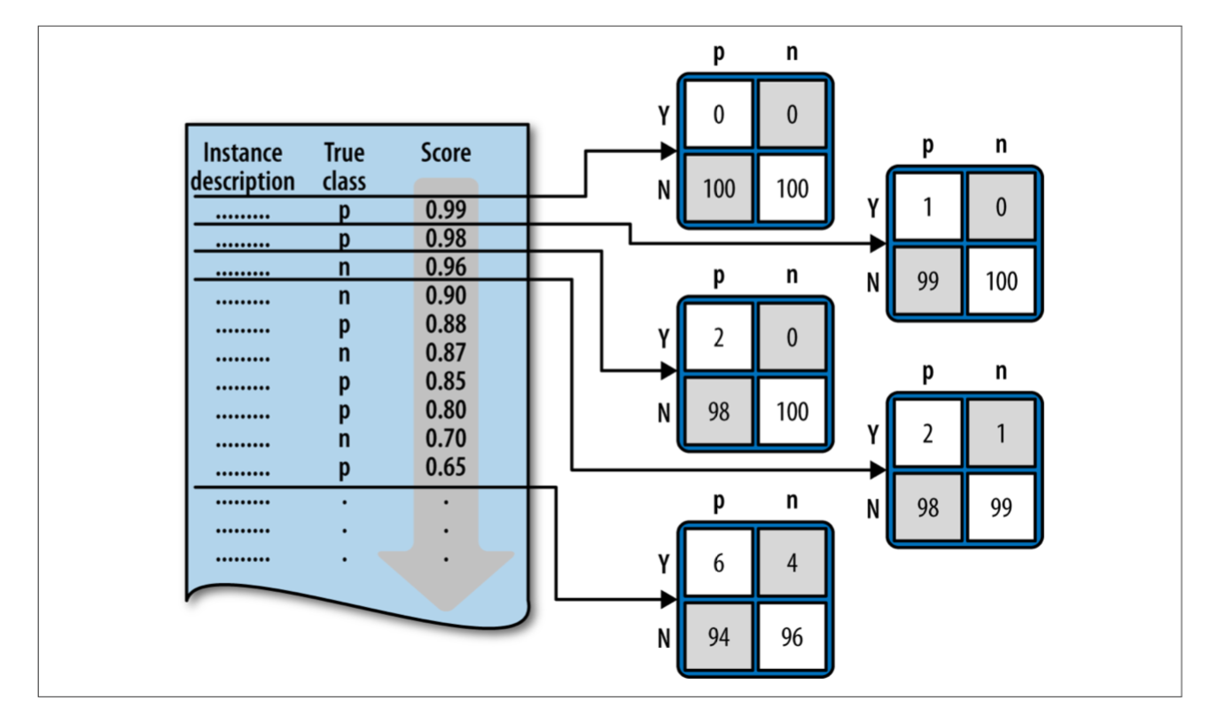
From DSB
Notes:
Every single point (when sorted) generates a new confusion matrix…

Slide 36
Confusion Matrix example
 | Truth=1 | Truth=0 | Total
Pred=1 (+) | 4 (TP) | 2 (FP) | 6 (Pred+)
Pred=0 (-) | 3 (FN) | 11 (TN) | 14 (Pred-)
Total | 7 (Base+) | 13 (Base-) | 20 (N)
TP=True Positives: 4
FP=False Positives: 2
FN=False Negatives: 3
TN = True Negatives: 11
Pred+ = Predicted positive: 6
Pred- =Predicted negatives: 14
Baserate of positives (Base+/N): 7/20 = 35%
Baserate of negatives (Base-/N): 65%
P\A | Truth=1 | Truth=0
Pred=1 (+) | TP | FP | Pred+
Pred=0 (-) | FN | TN | Pred-
 | Base+ | Base- | N

Slide 37
Classifier Evaluation Metrics
P\A | Truth=1 | Truth=0
Pred=1 (+) | TP | FP | Pred+
Pred=0 (-) | FN | TN | Pred-
 | Base+ | Base- | N
Accuracy: (TP + TN)/N
Error rate: (FP + FN)/N
Precision: TP/Pred+
Exactness: what % of times we label positive are we correct?
Recall: TP/Base+
completeness – how many of the positives did we predict?
All of these change with the the cutoff!

Slide 38
Precision and Recall??
Truth | Model 1 | Cut 0.3 | Cut 0.5 | Cut 0.7
1 | 0.901 | 1 | 1 | 1
0 | 0.868 | 1 | 1 | 1
1 | 0.725 | 1 | 1 | 1
1 | 0.701 | 1 | 1 | 1
0 | 0.605 | 1 | 1 | 0
1 | 0.502 | 1 | 1 | 0
0 | 0.475 | 1 | 0 | 0
0 | 0.470 | 1 | 0 | 0
0 | 0.466 | 1 | 0 | 0
1 | 0.435 | 1 | 0 | 0
1 | 0.430 | 1 | 0 | 0
0 | 0.327 | 1 | 0 | 0
0 | 0.315 | 1 | 0 | 0
1 | 0.309 | 1 | 0 | 0
0 | 0.281 | 0 | 0 | 0
0 | 0.268 | 0 | 0 | 0
0 | 0.227 | 0 | 0 | 0
0 | 0.190 | 0 | 0 | 0
0 | 0.100 | 0 | 0 | 0
0 | 0.158 | 0 | 0 | 0
Model predictions
Cut=0.7 | Truth=1 | Truth=0
Pred=1 | 3 | 1
Pred=0 | 4 | 12
Cut = 0.5 | Truth=1 | Truth=0
Pred=1 | 4 | 2
Pred=0 | 3 | 11
Cut = 0.3 | Truth=1 | Truth0
Pred=1 | 7 | 7
Pred=0 | 0 | 6
Notes:
What are the tradeoffs here?

Slide 39
Example
 | Truth=1 | Truth=0 | Total
Pred=1 | 90 | 140 | 230
Pred=0 | 210 | 9560 | 9770
Total | 300 | 9700 | 10000
Accuracy =
Error Rate=
Precision =
Recall =
P\A | Truth=1 | Truth=0
Pred=1 (+) | TP | FP | Pred+
Pred=0 (-) | FN | TN | Pred-
 | Base+ | Base- | N
‹#›

Slide 40
Evaluation Curves and Metrics

Slide 41
Evaluation Curves and Metrics
We have seen that the performance of a classification model depends on what the cutoff probability is
How do we define the overall performance of a model?
Three curves
There are actually many more options, but these three are the most used and useful
Precision-Recall Curves
ROC curves
Lift Curves

Slide 42
Baserate as Baseline
Truth | Model Prediction
1 | 0.901
0 | 0.868
1 | 0.725
1 | 0.701
0 | 0.605
1 | 0.502
0 | 0.475
0 | 0.470
0 | 0.466
1 | 0.435
1 | 0.430
0 | 0.327
0 | 0.315
1 | 0.309
0 | 0.281
0 | 0.268
0 | 0.227
0 | 0.190
0 | 0.100
0 | 0.158
Formally the term ‘baserate’ applies to a class
(default or no default) and is the unconditional
(no model) probability of the true labels
Example on the right
baserate of success (Truth=1) = 35%
baserate of failure = 65%
‘Baserate’ of a dataset can be either for class 1 or class 0, usually the context will tell
Default can be 0 or 1, but typically 1 is the code for the thing of interest (e.g. purchase, disease, fraud)
With two outcomes, “1” is typically used for minority class
We use the term ‘balanced’ to refer to how close the two baserates are to 0.5
You can always do “as well as” the baserate!

Slide 43
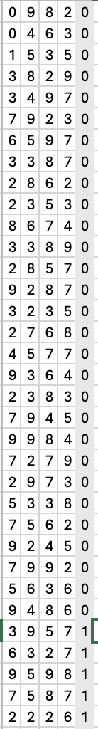
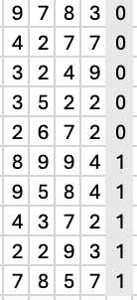
Problems with Unbalanced Classes
features
fraud
Many cases are highly unbalanced – think churn, where maybe 0.1% or less are churn cases, this makes it hard to find models to fit that signal
Also makes precision and recall hard to interpret
In this case, you may want to sample from the non-churn to have equal cases as churn.
This balanced data might have 50% churn cases
Random
99.9%
not fraud
Balanced
Data
0.1 %
fraud

Slide 44
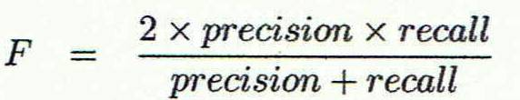
1) Precision/Recall Tradeoff:
High Precision:
Use a high cutoff.
Want to be really sure that those predicted true are really true!
Use when the cost of a false positive is high
Example: Medical tests?
High Recall
Use lower cutoff
When you want to be sure to get as many positive cases as possible
Use when the cost of a false positive is not so high
Example: advertising? Fraud?
If you want the best of both worlds, you can use the F-measure
Notes:
harmonic mean
= .35 for example on last slide

Slide 45
Precision recall curve
Recall that Precision and Recall change with each value of the cutoff

Slide 46
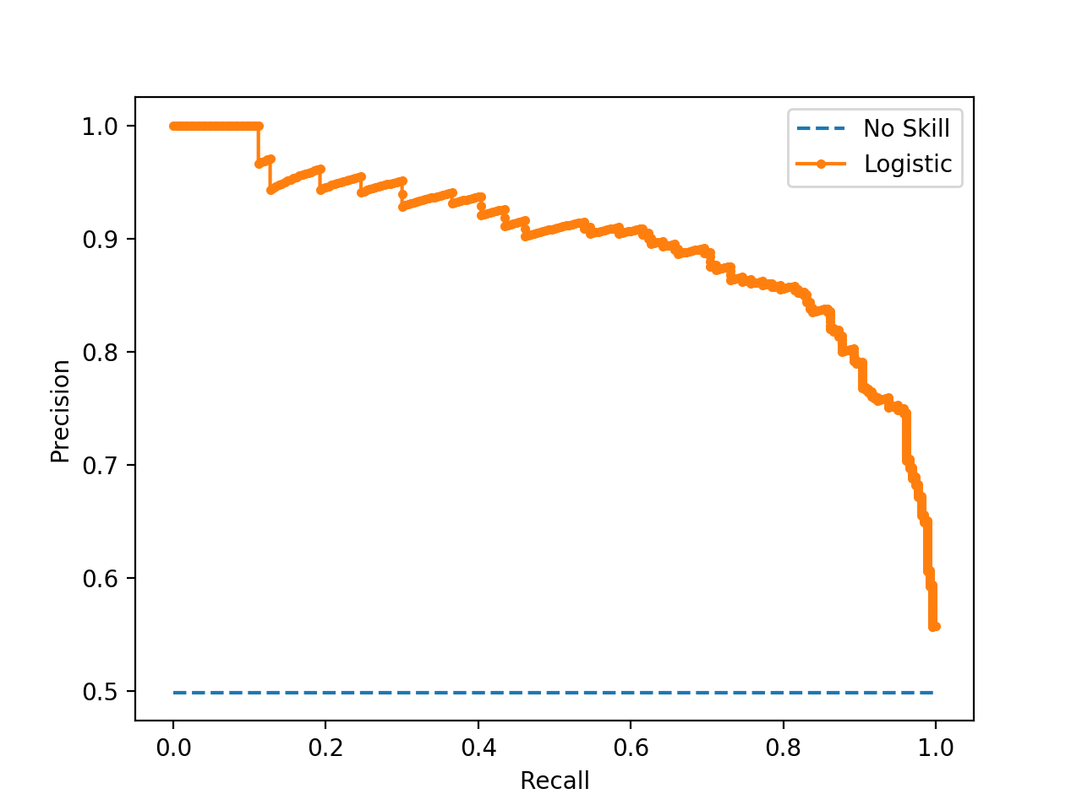
Precision recall curve
from sklearn.metrics import PrecisionRecallDisplay
Plot precision vs recall for each possible cutoff
Precision = 1 when recall is close to 0, and vice versa.
Can also note performance of a baseline model
Truth | Model Prediction
1 | 0.901
0 | 0.868
1 | 0.725
1 | 0.701
0 | 0.605
1 | 0.502
0 | 0.475
0 | 0.470
0 | 0.466
1 | 0.435
1 | 0.430
0 | 0.327
0 | 0.315
1 | 0.309
0 | 0.281
0 | 0.268
0 | 0.227
0 | 0.190
0 | 0.100
0 | 0.158

Slide 47
However..
Precision and recall are useful metrics to compare two different models
i.e. two models with the same precision may have different recalls, the one with more recall is better (F-value)
But, precision is not always useful
Remember the example: imagine a model that is predicting whether someone clicks on an ad
99.9% of people do not click on the ad
Model can easily get 99.9% precision!
What would the recall be in this scenario

Slide 48
Ranking Models
One thing to notice – the P/R curve doesn’t contain the actual cutoffs, it is determined by the ranking of the test data cases
In fact, for some data science tasks, all that matters is that we rank the test cases, the actual probabilities don’t matter
Helpful because probabilities are hard to validate!
Can you think of an example?
Some of our evaluations only depend on rankings
Notes:
e.g. if we have a budget and can only send a certain number of cases…

Slide 49
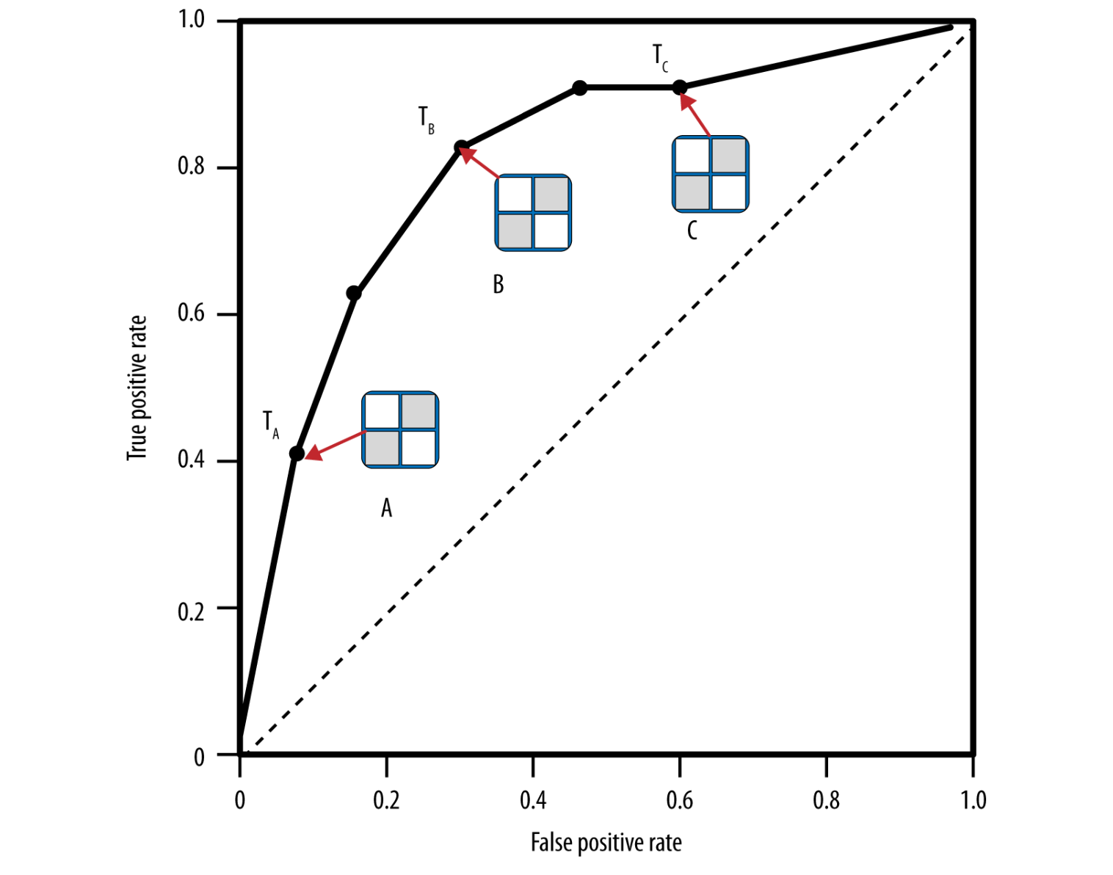
2) ROC Curve
ROC = receiver operating characteristic (yuck)
ROC curves trade off
Benefit (true positive rate)
Cost (false positive rate)
Each point in the ROC space corresponds to a different cutoff
Can compare easily to a “random” model
True Positive Rate = TP/Base+
Recall, or “hit rate”
False Pos Rate = FP/Base-
“false alarm rate”
P\A | Truth=1 | Truth=0
Pred=1 (+) | TP | FP | Pred+
Pred=0 (-) | FN | TN | Pred-
 | Base+ | Base- | N

Slide 50
ROC Curve
Perfect Model
(1,0)
1.0
0.9
”Good” models are further from random line
0.8
Everything predicted +
(1,1)
true positive rate (TP)
A
Line represents null or random model
0.2
0.1
0
Nothing is predicted +
(0,0)
0
0.1
0.2
false positive rate (FP)
0.8
0.9
1.0
decreasing cutoff

Slide 51
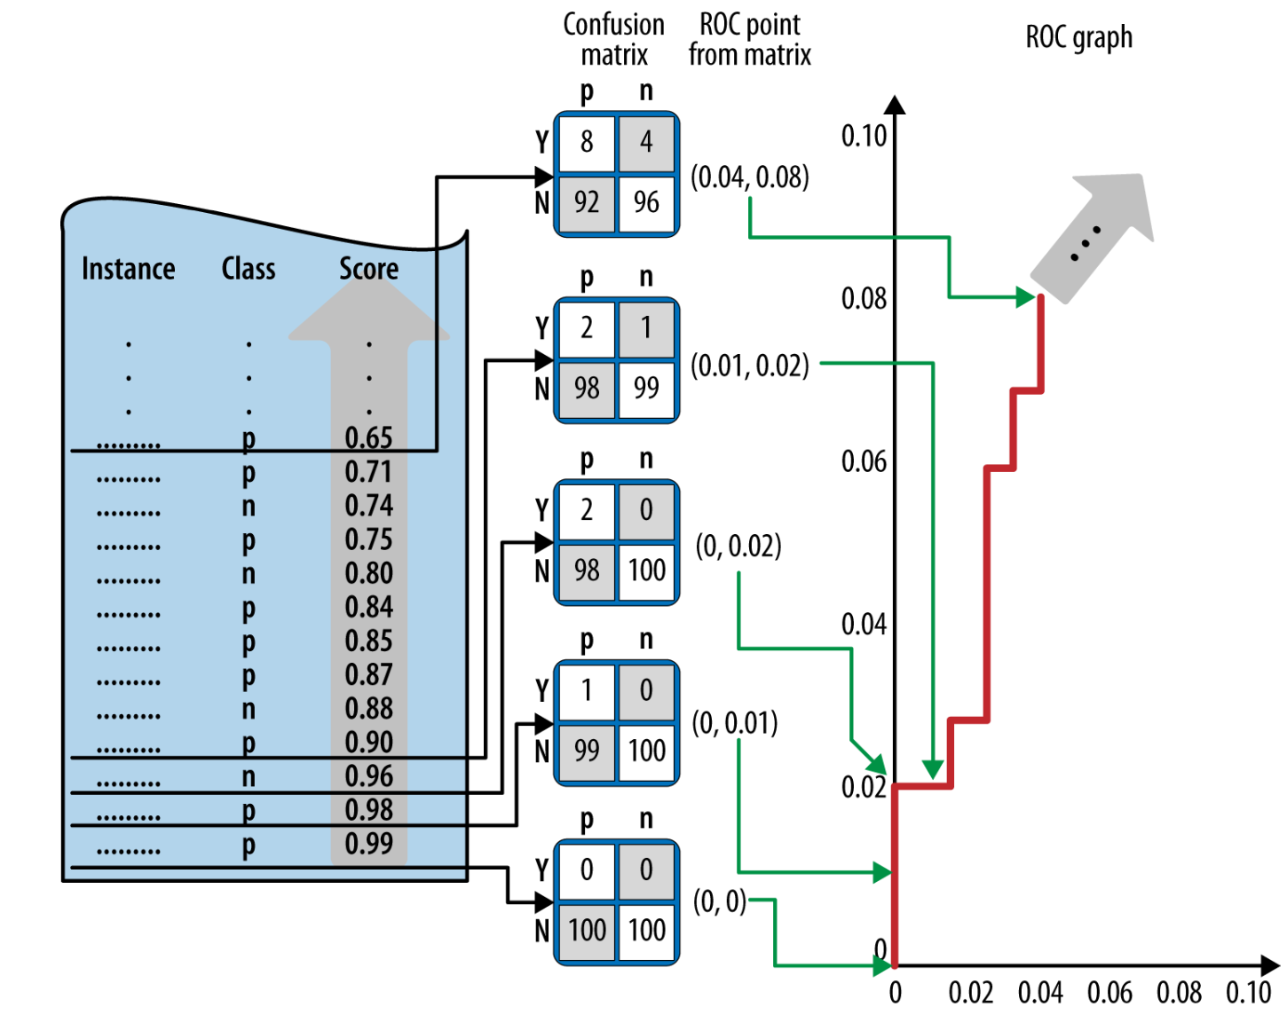
Example from DSB
PF p 218

Slide 52
Why ROC?
Has some nice qualities
The underlying probabilities are not relevant
Only measures the quality of the ranking
Not impacted by the baserate
All curves go from (0,0) to (1,1)
Allows comparisons of different models, even different data sets
Allows itself to a single metric of performance for a given model, regardless of baserate …

Slide 53
AUC
from sklearn.metrics import roc_auc_score
AUC = Area under the ROC curve
Literally just the calculated area under the ROC curve
Has become a standard metric for machine learning models due to some nice properties
Measures the overall ranking quality of the model
Interpretation: probability that model will rank a positive case higher than a negative case
Robust to outliers
Independent of baserate
Bounded between 0 and 1
0.5 means no better than random model

Slide 54
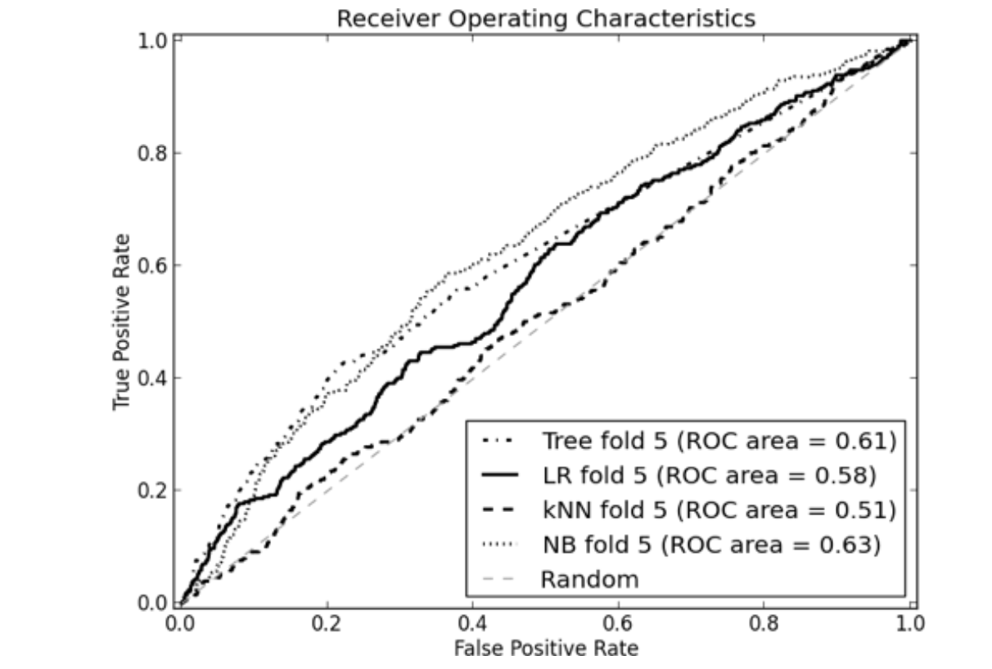
AUC examples
Easy to compare models, to baseline and to each other
More “northwest” a model is the better it is
Higher AUC is better
DSB p 227

Slide 55
3) Lift Curve
ROC curves are good for showing across the entire dataset how well you compare to a “random” model
Sometimes that is the most important thing!
Example: Churn
Lets say I can only go with a retention offer to 3% of my customers. How much better is my model than blind selection of 3%?
How many of my churners do I expect to find if I randomly select 3% of customers?
If my model is good, how many of my churners do I expect to capture in the top3% of my churn score?

Slide 56
Lift Curve
Lift curves directly address this question
Very similar to ROC curves.
Lift: improvement obtained over randomness (aka, the value of the model)
To calculate the lift, we introduce *yet another* curve, the cumulative response curve…(also called cumulative gains)
Cumulative Response plots :
- True Positive Rate on y-axis (same as ROC)
Vs.
- Percentage of population targeted (simply – number of observations, does not depend on the model)

Slide 57
Cumulative response curves
100
C
90
80
B
TP/Base+
D
Lift for Model A at 50% = the improvement over the random model: i.e. 65%/50% = 1.3
true positive (TP)
A
20
Lift for Model A at 10% = the improvement over the random model: i.e. 40%/10% = 4.0
Lift for Model A at 1% = the improvement over the random model: i.e. 9%/10% = 9.0
10
0
100
0
10
20
% targeted
80
90
decreasing cutoff
Pred+/N

Slide 58
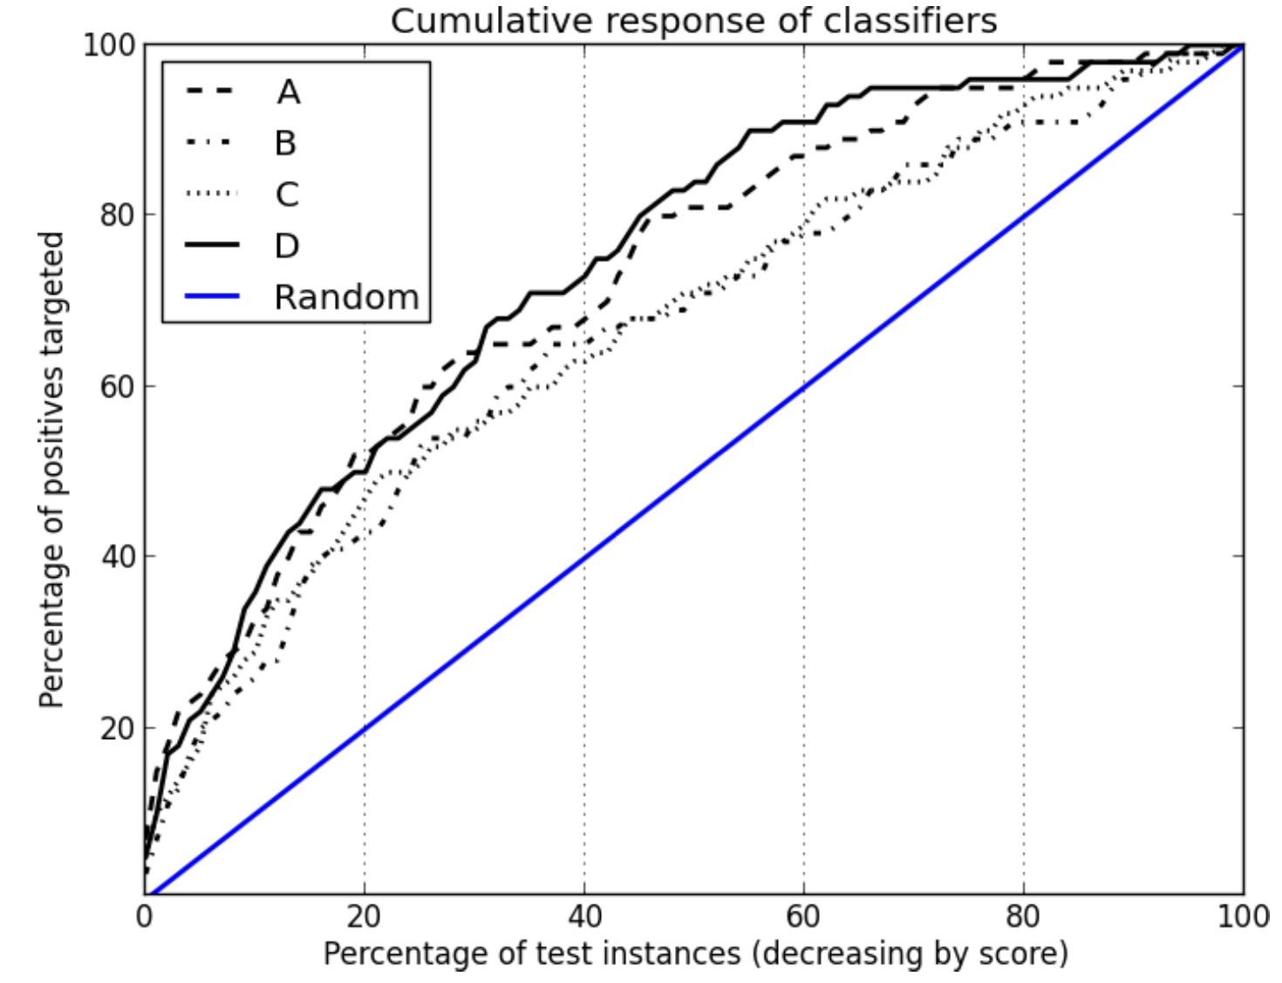
Cumulative response curves => Lift
recall
Lift for Model A at 50% = the improvement over the random model: i.e. 80%/50% = 1.6
Lift for Model A at 10% = the improvement over the random model: i.e. 37%/10% = 3.7
Lift for Model A at 1% = the improvement over the random model: i.e. 7.5%/1% = 7.5
Pred+ / N

Slide 59
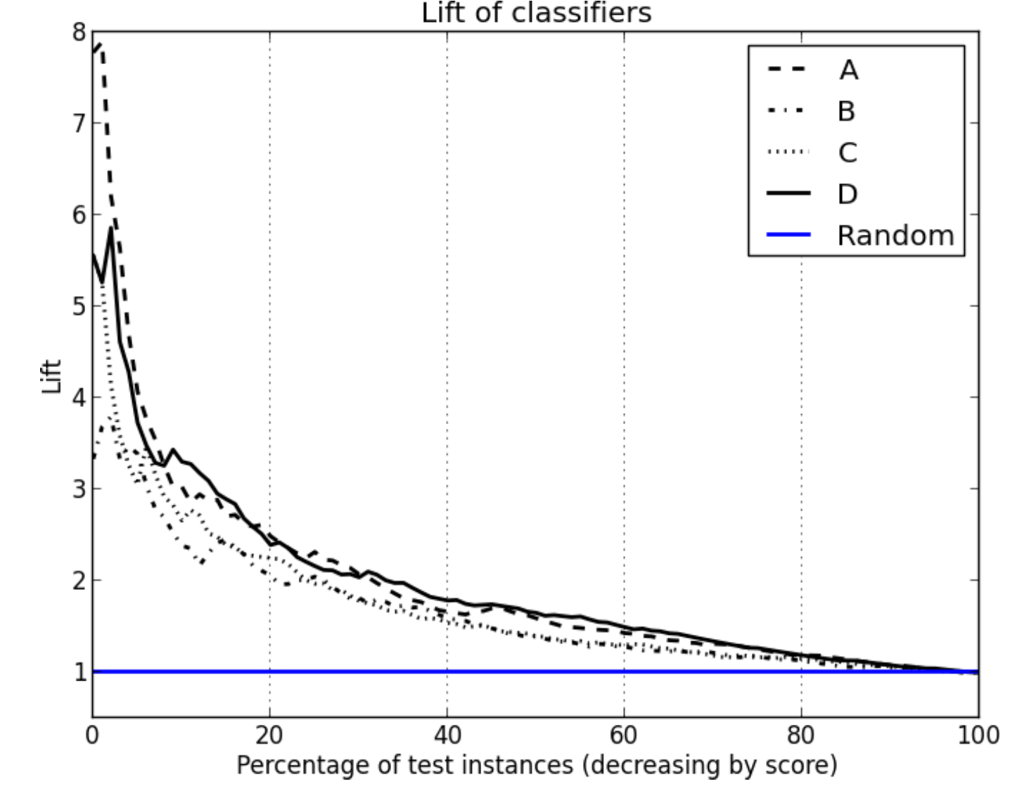
From Cumulative Response to Lift
Lift Curve plots the lift from the Cumulative Response Curve in order to highlight the improvement over the random model – particularly at the points of highest precision

Slide 60

So Many Curves!
We have learned about:
Precision-Recall Curves
ROC curves
Lift Curves
What to use?!?!?!
ROC Curves (and particularly AUC) are a standard way to give overall performance of a model and compare between models.
P/R curves: are good for imbalanced datasets because they only depend on ranks. You can clearly see the balance between precision and recall. BUT they depend on the baserate and so not comparable between data sets.
Lift curves are used when “overall” accuracy is less important and you really care about how well you can ”slice off” the most likely cases.
Can be field-specific. (Marketing => Lift curves)
As always, depends on the business problem, the audience, and the need for interpretability!!
Notes:
Don’t care about performance outside of the top 1% or 10%

Slide 61
Evaluation using Expected Value

Slide 62
Using Expected Value for Evaluation
Earlier when we talked about confusion matrices, we discussed how different errors (False Positive or False Negative) might have different costs based on the problem
Similarly, the benefit of getting the right classification might have different benefits
The Expected Value Framework is a way to incorporate these directly into the evaluation – and also help to set the cutoffs
 | Truth=1 | Truth = 0
Predicted = 1 | True Positives (TP) | False Positives (FP) | Total Predicted +
Predicted = 0 | False Negatives (FN) | True Negatives (TN) | Total Predicted -
 | Total True + | Total True - | Total n

Slide 63
Cost/Benefit Matrix
Imagine it costs $1 to send a solicitation and assume that if someone donates they donate on average $10. Then what is the net cost/benefit matrix?
B=Benefit (can be negative if there is a cost)
 | Response= + | Response = -
Solicitation = Y | B(Y,+) = 9 | B(Y,-) = -1
Solicitation = N | B(N,) = 0 | B(N,-) = 0
The Expected Value of money you make if you send the solicitation depends on the probability of them responding
EV(solicitation = Y) = P(+|Y) x B(Y,+) + p(-|Y) x B(Y, -)
Comes from model

Slide 64
Cost/Benefit Matrix
 | Response= + | Response = -
Solicitation = Y | B(Y,+) = 9 | B(Y,-) = -1
Solicitation = N | B(N,-) = 0 | B(N,-) = 0
B=benefit
The Expected Value of money you make if you send the solicitation depends on the probability of them responding
EV(solicitation = Y) = P(+|Y) x B(Y,+) + p(-|Y) x B(Y, -)
Let p = the probability that they respond (from model)
EV = p x 9 + (1-p) x (-1)
EV > 0 if p> 0.1, so you would act if the probability is > 0.1
EV(solicitation = N) = P(+|N) x B(N,+) + p(-|N) x B(N, -) = 0
Notes:
This is very flexible…maybe you assume there is a cost if you don’t send it, or maybe you assume they might reply even if you don’t send it…

Slide 65
Cost/Benefit Matrix
The purpose of that exercise:
If you make some assumptions about the costs and benefits of your actions, you can use profit as a way to evaluate your models, and set cutoffs.
In general, the profit of a given model is a combination of the cost/benefit matrix and the confusion matrix.
P\A | Truth=1 | Truth=0
Pred=1 (+) | TP | FP
Pred=0 (-) | FN | TN
P\A | Truth=1 | Truth=0
Pred=1 (+) | B(TP) | B(FP)
Pred=0 (-) | B(FN) | B(TN)
x
Profit per observation= TP/n x B(TP) +
FP/n x B(FP) +
FN/n x B(FN) +
TN/n x B(TN)
Note, this only works if the TP/FP matrix is in rates or percents
aka all values should add to 1 (or 100)
Notes:
Do the example here with 10k !!!
90 140
210 9560
10 x .009 + -1 x .014 = 0.076 – this is the profit per customer.

Slide 66
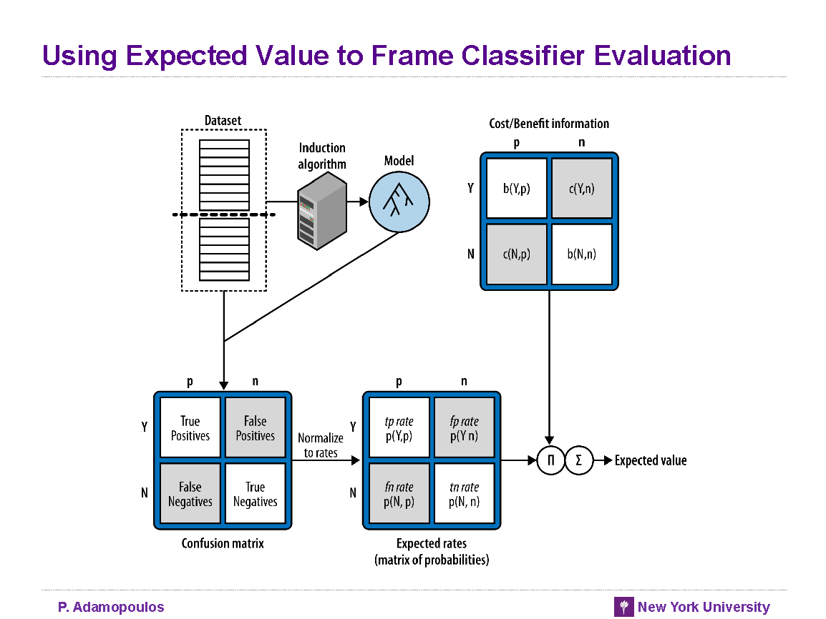
DSB p.212
Can plug in every different value, and estimate profit

Slide 67

Case Study
Modems in Broadband service
AT&T has a broadband service with tens of millions of customers
We would regularly get calls from customers with router problems.
BUT many problems are fixed with a simple router reboot
We can do router reboots remotely!
The customer care cost of a call + fix is $10 per call
The network cost to implement the fix remotely is $1
We could build a model – based on network diagnostics - to predict if a customer had a problem that was fixable via remote reboot
Dall-E: “image of customer calling customer care with a network problem”

Slide 68

Case Study
Modems in Broadband service:
Build a model and sort by likelihood to have a problem
Need to choose a threshold above which we will remotely reboot the router.
The threshold we choose will determine how many routers we remotely reboot.
What does the cost/benefit matrix look like?
What are the precision / recall for the three error matrices below?
What is the F-measure at each level?
What is the profit at each level?
Dall-E: “can you make the image more realistic and less cartoony?”
TP/FP given in %s
Cut #1 | Truth=1 | Truth=0
Pred=1 | 2 | 3
Pred=0 | 8 | 87
Truth | Model Prediction
1 | 0.901
0 | 0.868
1 | 0.725
1 | 0.701
0 | 0.605
1 | 0.502
0 | 0.475
… | …
… | …
… | ..
Cut #2 | Truth=1 | Truth=0
Pred=1 | 5 | 20
Pred=0 | 5 | 70
Cut #3 | Truth=1 | Truth=0
Pred=1 | 8 | 60
Pred=0 | 2 | 30

Slide 69
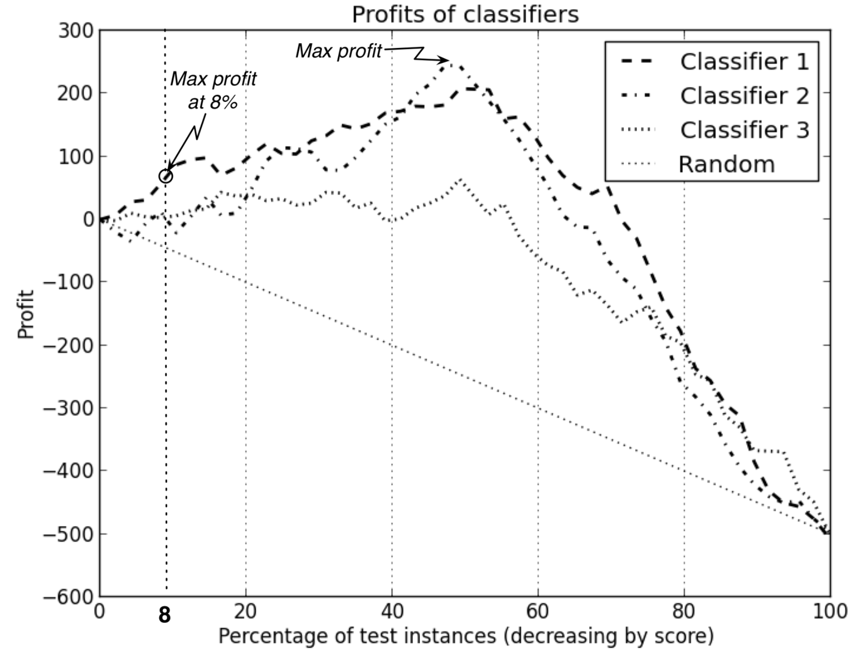
Profit Curves
This brings us to YAC (yet another curve) that tries to incorporate the idea of profit and expected value into the classifier.
How this is done is very problem specific and typically requires many (informed) assumptions!
DSB p213

Slide 70
Cost / Benefit Matrix
It can get even more complicated
Charity example: what assumptions are you making with this matrix?
 | Response= + | Response = -
Solicitation = Y | B(Y,+) = 9 | B(Y,-) = -1
Solicitation = N | B(N,) = 0 | B(N,-) = 0
Notes:
First: that the error is zero – be careful, not to double count the error
Also, That everyone has the same donation!

Slide 71
Expected value for each example: Different Benefits
Each person has a different predicted benefit!
EV(solicitation = Y) = P(+|Y) x B(Y,+) + p(-|Y) x B(Y, -)
EV(not action) = 0
Take action if EV(Y) > 0 – might be different for each customer
Example:
EV=0.068* 73 + (1-0.068) * -1 = 4.032
Decision: Send! (even though probability is low, the potential benefit is high enough
p(+) | predicted $
0.115488 | 10
0.001226 | 5
0.005427 | 2
0.067951 | 12
0.015874 | 75
0.025487 | 25
0.023191 | 30
0.022713 | 15
0.029746 | 5
0.088972 | 25
0.067847 | 73
0.066123 | 59
0.075126 | 2
0.080805 | 14
0.009164 | 10
Notes:
can get even more complicated if we consider variance…

Slide 72
Calibration
Truth | Model 1
1 | 0.956651
1 | 0.935024
0 | 0.86795
1 | 0.825154
1 | 0.780694
1 | 0.701226
0 | 0.693006
1 | 0.625487
0 | 0.605427
1 | 0.601707
0 | 0.579525
0 | 0.569616
1 | 0.538551
1 | 0.488972
0 | 0.482967
0 | 0.475126
0 | 0.466123
1 | 0.429746
1 | 0.425835
But how do you know if your probabilities are good?
We cannot observe probabilities!
Calculate empirical probabilities by making buckets:
Sort the predictions by probability
Pick groups of predictions as ‘buckets’
Calculate average predicted probability
Calculate empirical probability: average truth
Particularly important in this scenario:
Training Data
(80%?)
Test data
(20%?)
deployment examples
‹#›

